Slide 1
CZ3002 Presentation
Team Luck
Bian Hengwei
He Yinan
Jin Han
Lee Yu Jie Melvin
Renganathan Ramasamy
Sannabhadti Shipra Deepak

Slide 2
Team Members
Name | Role | Matric No.
Bian Hengwei | Project Manager | U1923732B
He Yinan | Back-end Developer | U1922693C
Jin Han | Front-end Developer | U1922733A
Lee Yu Jie Melvin | QA Manager/QA Engineer | U1922533G
Renganathan Ramasamy | Lead Developer | U1922494L
Sannabhadti Shipra Deepak | Release Engineer/Manager | U1822459L

Slide 3
Outline of Presentation
Product Introduction
Design for Maintainability
Software Quality Assurance
Project Management
Risk Management
Demo

Slide 4
Project Introduction

Slide 5
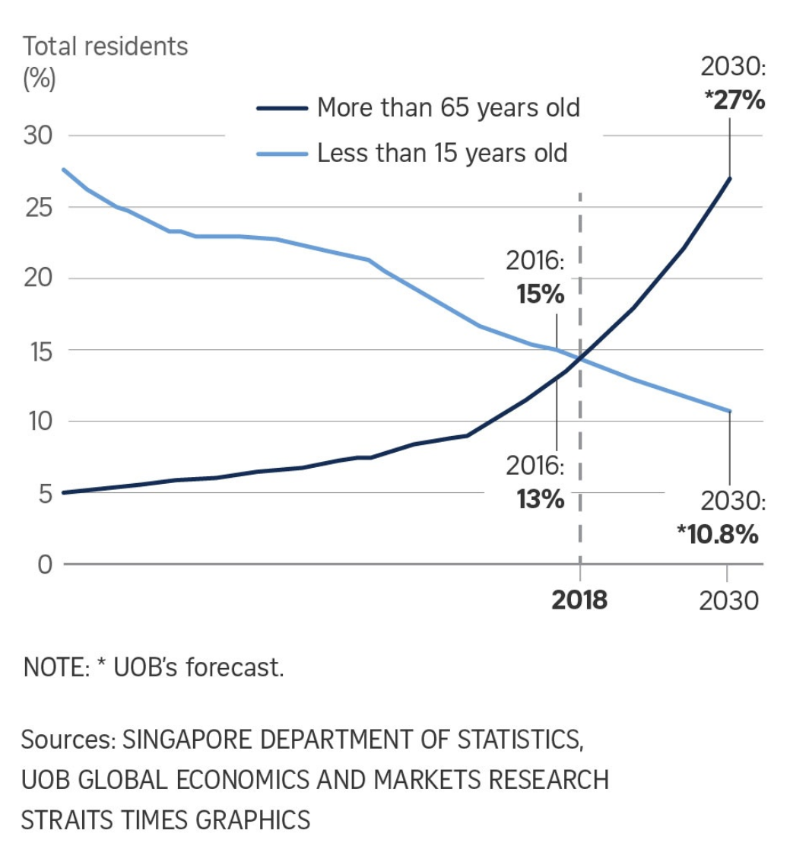
Background
Elderly comprise about 14% of Singapore’s population.
Elderly population is expected to increase to over 25% by 2030.
Prevalence of dementia is 10% in the elderly population
Researches have shown that cognitive training slows down the cognitive declines associated with aging.
Notes:
We have found out that elderly comprise about 14% of singapore’s population and this number is expected to increase exponentially to more than 25% by 2030. As our population ages, dementia, which 10 percent of the elderly population suffers, may be a more significant problem in the future. Research has shown that cognitive training may decelerate the cognitive declines associated with aging, so we decided to make a mobile game to encourage cognitive training.

Slide 6
Overview
User Authentication
Login
Register
Forget Password
Room management
Create
Join
Private vs Public
Play Game
Game flow
Leaderboard
Notes:
Our application comprises of 3 main parts, I will now go through them one by one.

Slide 7
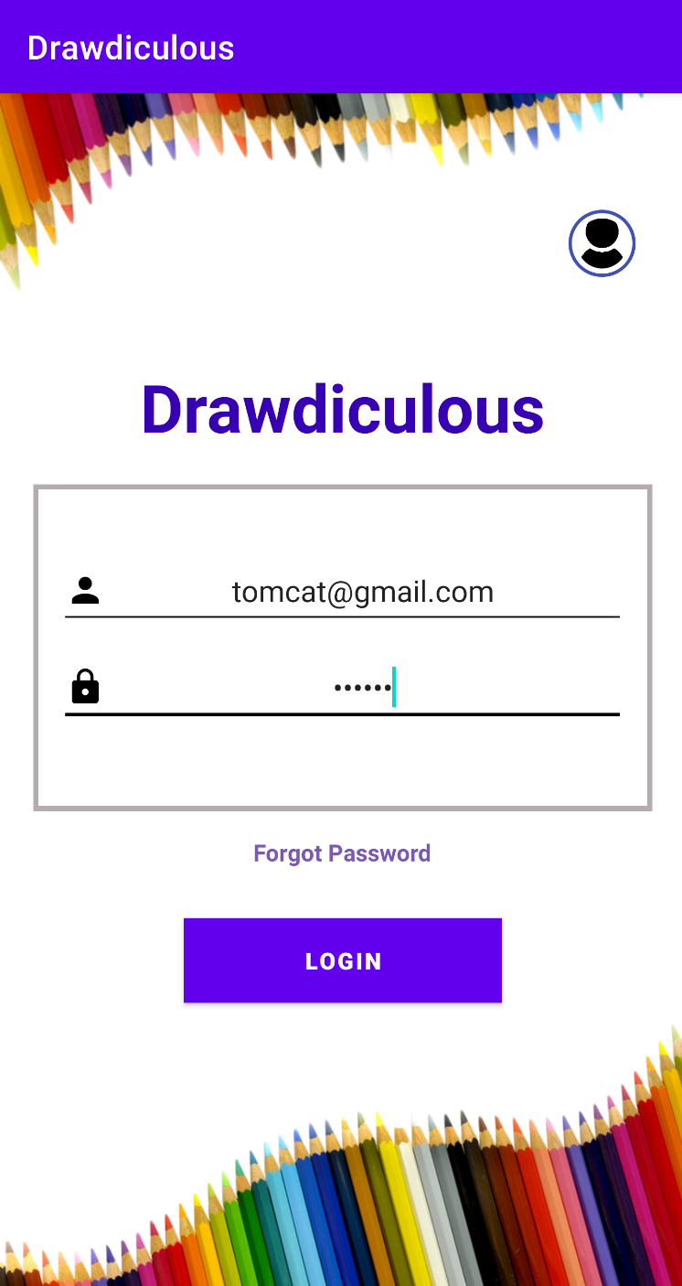
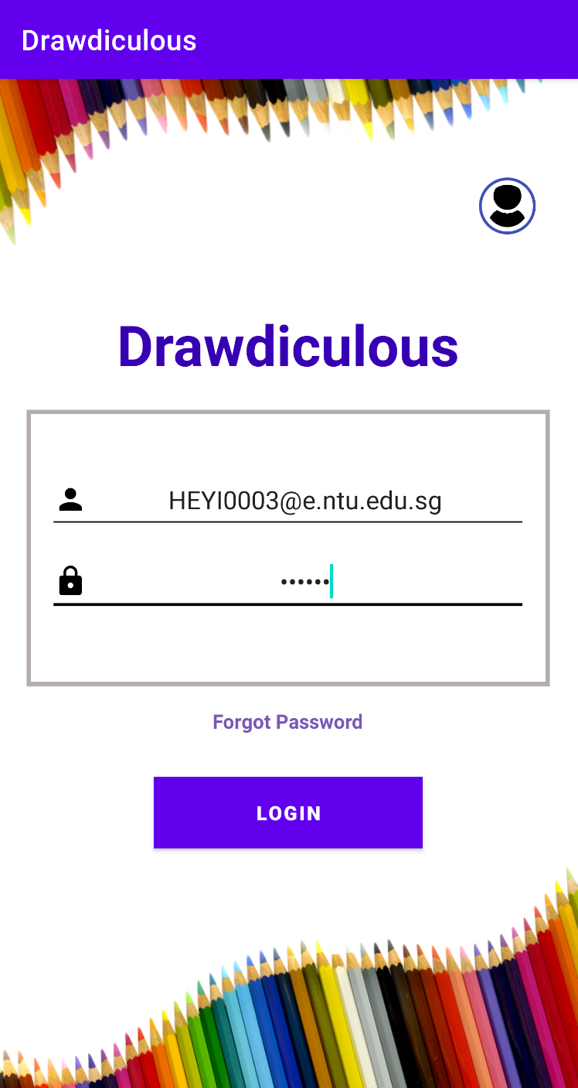
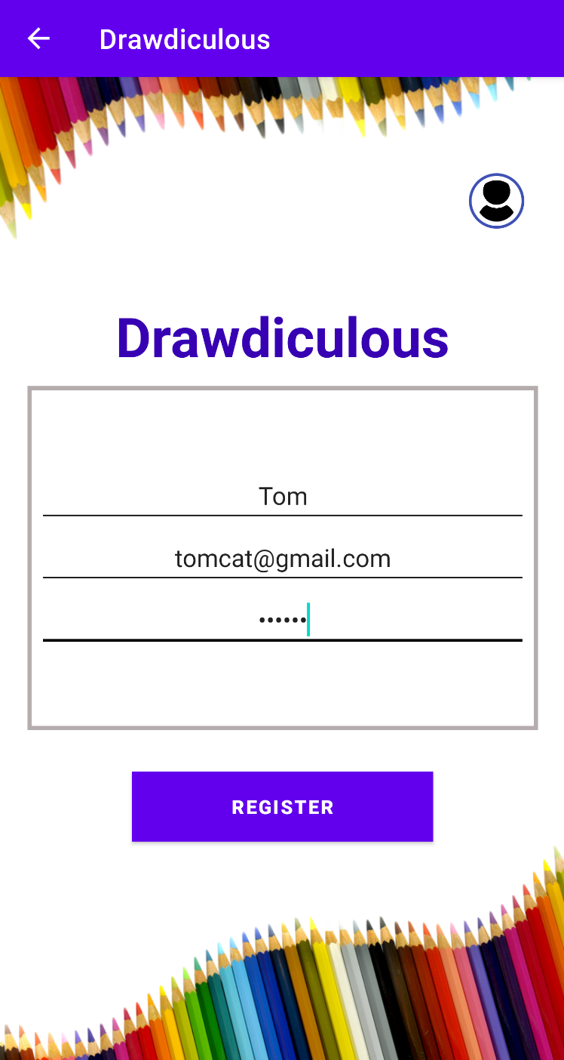
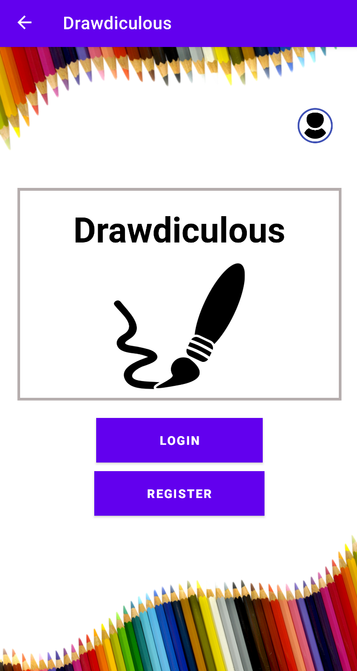
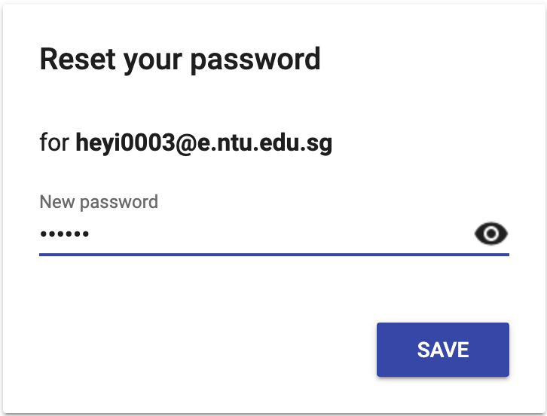
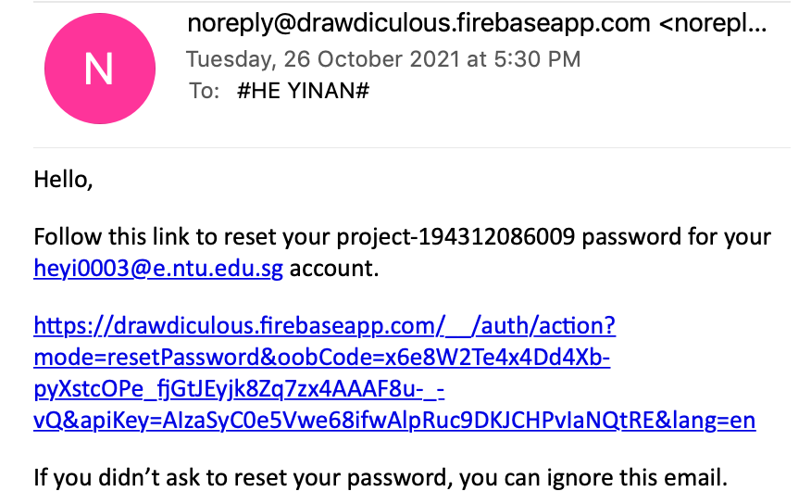
User Authentication
Registration
Register with user name, email address and password.
Handles exception in inputs.
Login
Using email address and password.
Forget password
Enter email address to get the link to reset password.
Notes:
To use our application, user first need to register an account by providing a username, email address and password. After registration, user can proceed to login using their email address and password. Our application also has forget password function to send a hyperlink to user’s email and allowing user to reset their password.

Slide 8
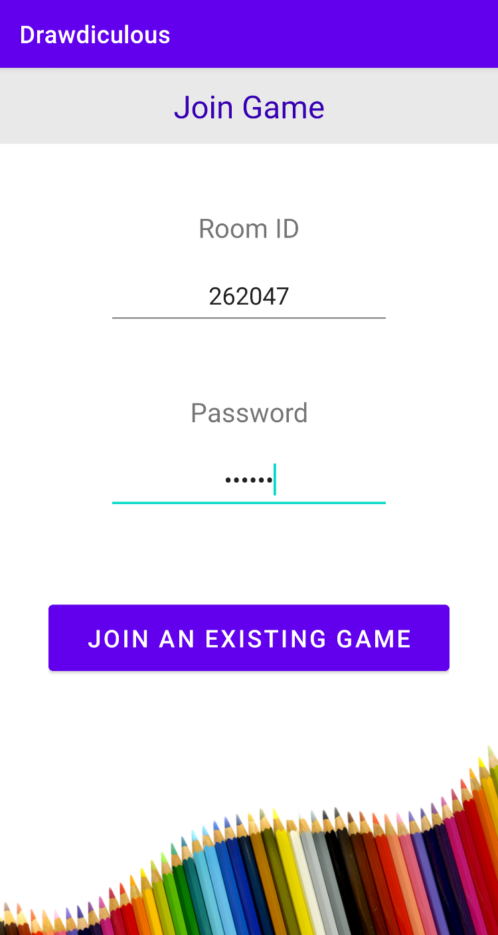
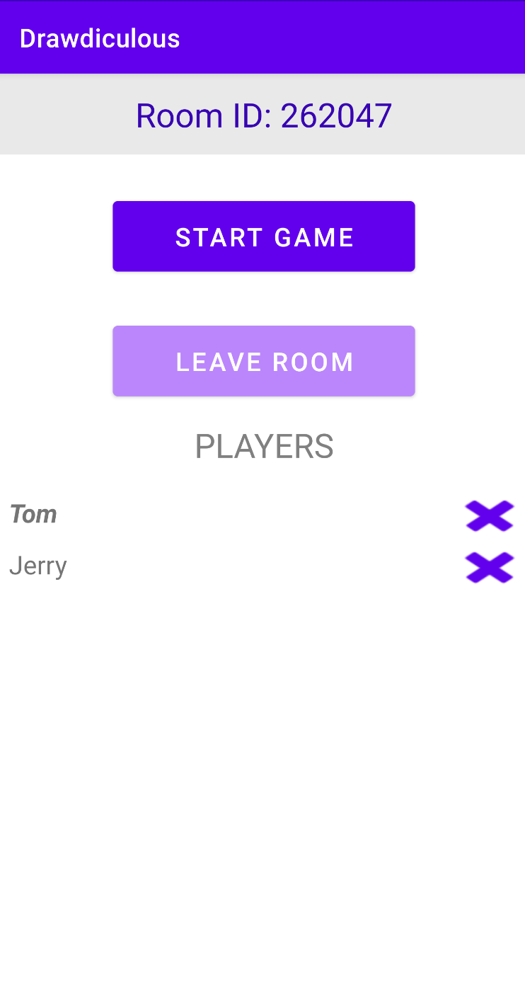
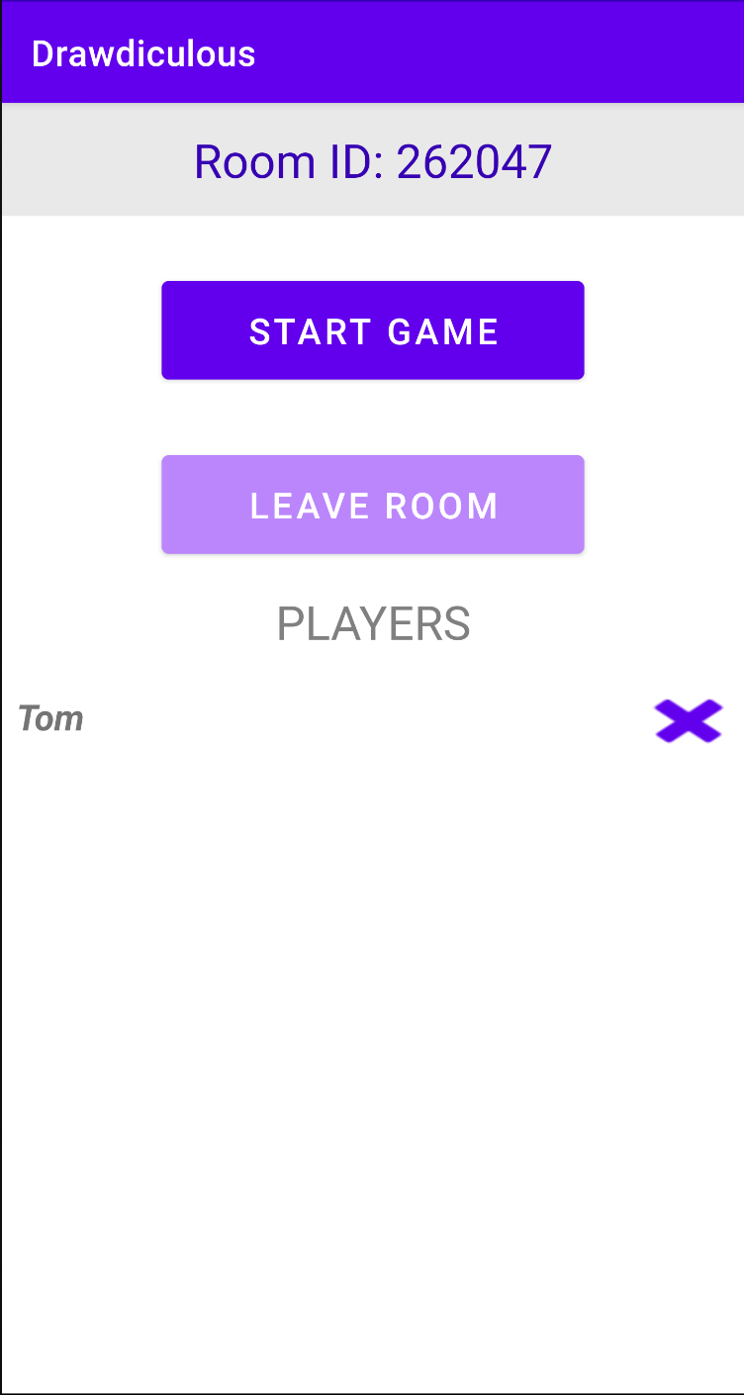
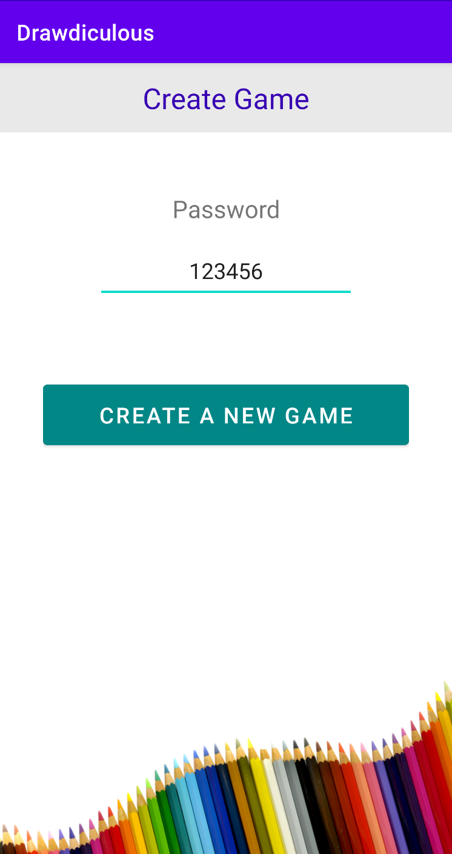
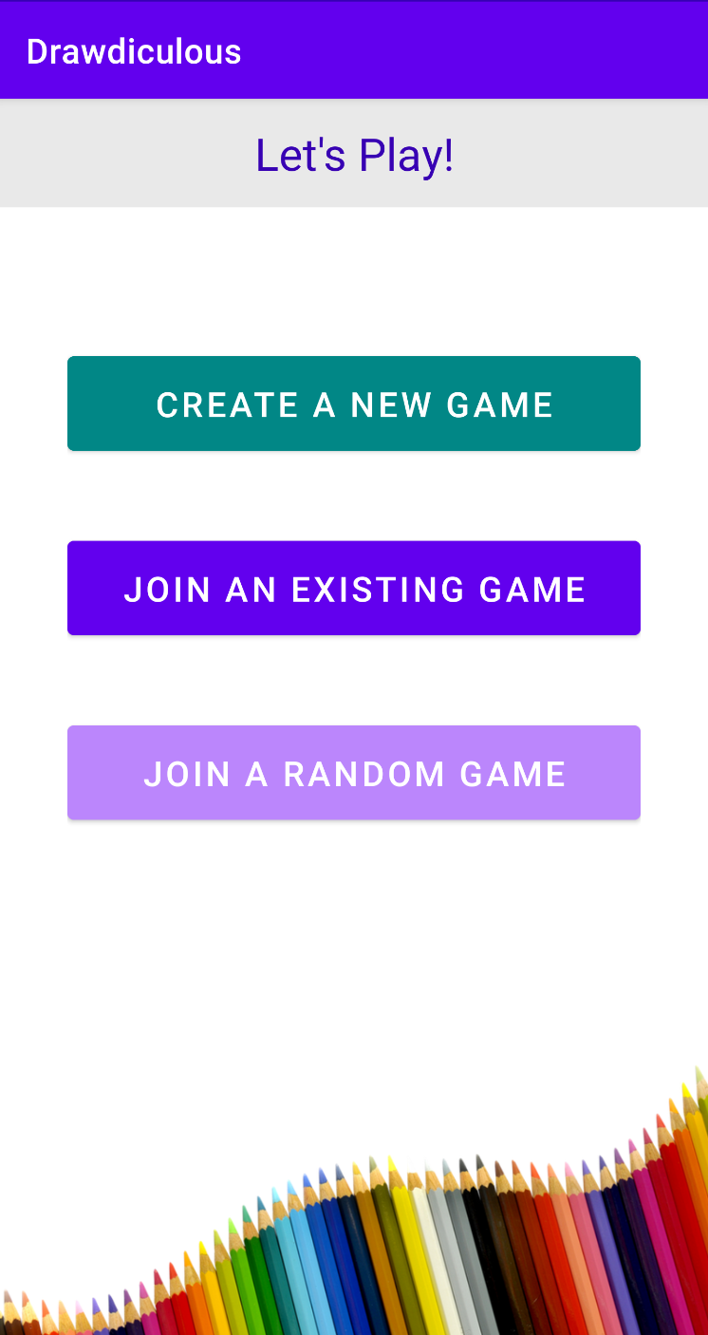
Game Room Management
Create room
Public room
Private room
Join room
Join private room
Join random public room
Leave room
Player can leave room
Room closes if room host leaves the room
Remove player
Room host may remove a player from the room
Notes:
After login, user can create a room to play the game. User can choose to enter a password to make the room private, or leave it empty to create a public room. For this case, Tom created a new room and he is inside it.
Users can choose to join a specific room by keying in the room id and password. For this case, jerry joined the room that tom previously created. Now both jerry and tom will be inside the room.
The users inside a room can leave the room by clicking on the leave room button. The room host can choose to remove players by clicking on the x button.
User can also choose to join a random public room by clicking on this button in the red box.

Slide 9
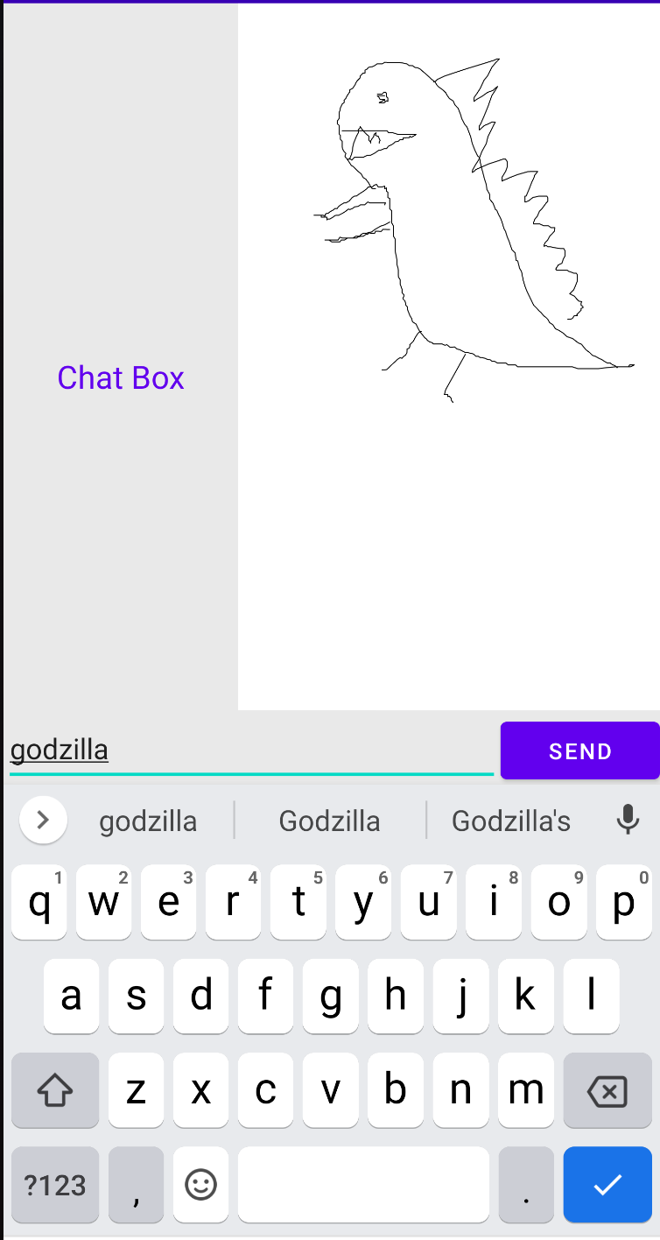
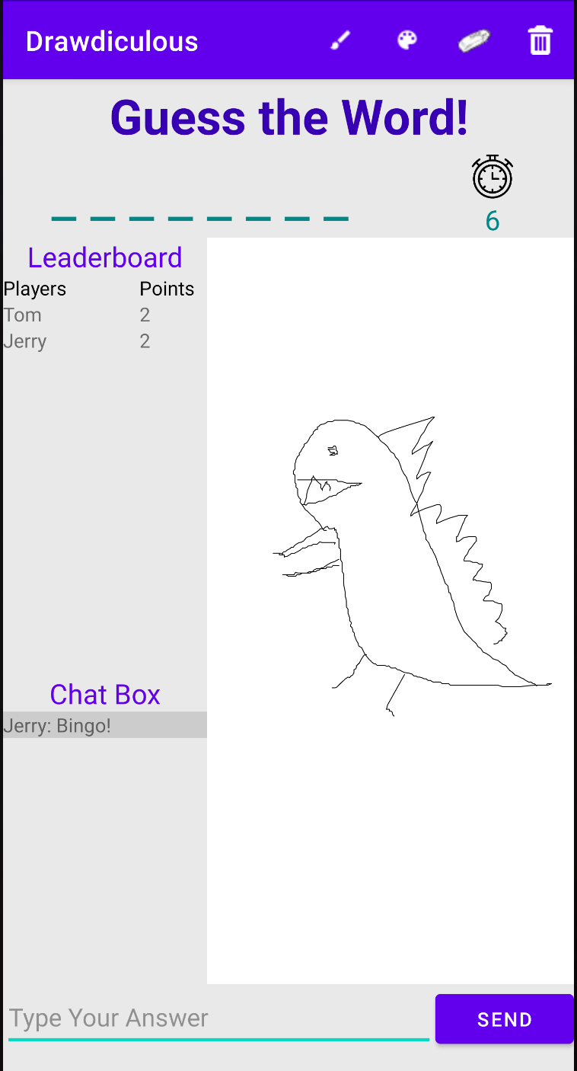
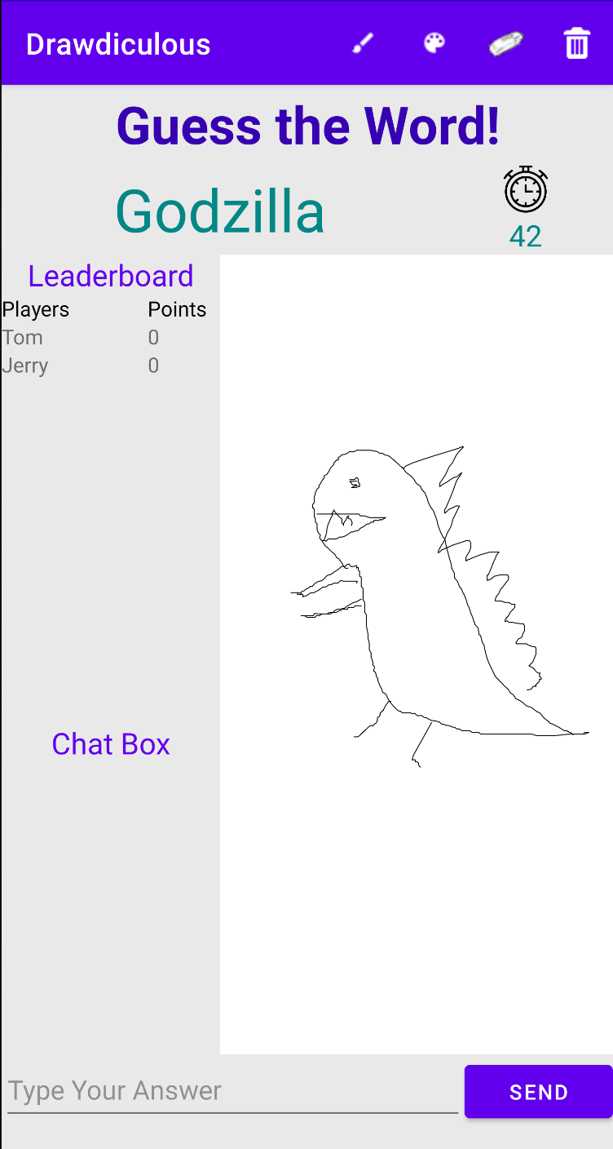
Play Game
Each player will take turns to be the drawer.
Game will provide drawer with a single word prompt
Drawer have 5 seconds to prepare before round starts
Drawer have 90 seconds to draw on the canvas
Other players can attempt to guess the prompt within the time limit
Both drawer and player will receive points as rewards if answered correctly, points received
Notes:
To play the game, the room host will have to click on the start game button. The drawer, which is currently tom, will be assigned a single word and the drawer will attempt to draw a picture that resembles this word. The other players can make guesses by sending their answers in the chat. If the answer is correct, a bingo will be displayed and both the drawer and the player that answered correctly will be awarded points.

Slide 10
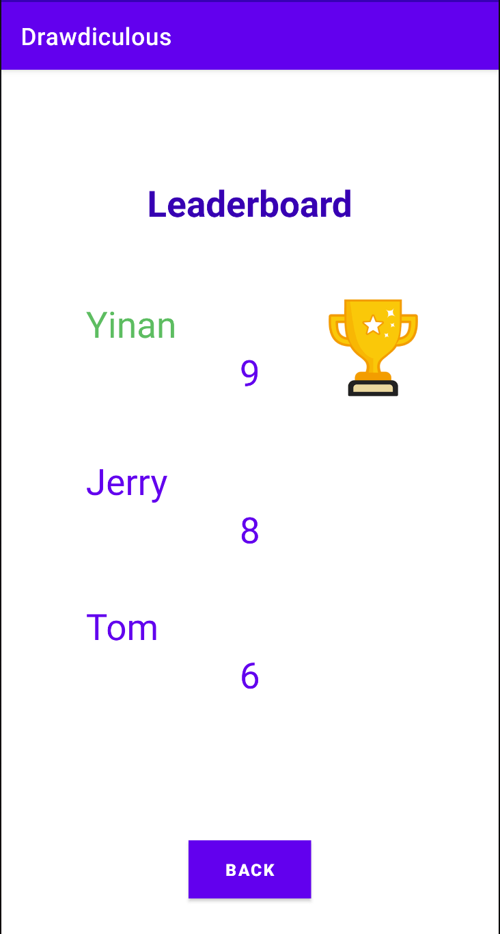
Play Game
Leaderboard
Score awarded to player is based on the sequence player answers correctly
Display the final score of players
Notes:
Game scores are awarded based on the sequence in which players answer.
After the game finishes, the final leaderboard will be displayed, with the highest scorer being the winner.

Slide 11
Design for Maintainability
Notes:
Thank you for the introduction Yinan. I’m Shipra and I’ll be going over the Design for Maintainability section of today’s presentation.

Slide 12



Early Planning Strategies
Frequent brainstorming sessions
Implement and test features atomically
Ensure readable code and comprehensive documentation
Notes:
The team decided on certain strategies during our planning phase. These include:
Setting aside time for frequent brainstorming sessions to allow for a continuous feedback loop
We also decided to implement and test features atomically so as to ensure our code is more modular, and will not be susceptible to easy disruption
Lastly, the team resolved to ensure readable code, and provide extensive documentation for the same

Slide 13



System Architecture
Client-Server Architecture
Client
Layered Architecture
Upper layer components interact with components in the layer directly below
Support the reuse of lower layer components
Benefits include modularity, simplicity, flexibility, scalability, portability, robustness and implementation stability
Instruction
Request
Response
Response
User
Server
Notes:
Now, let’s discuss the system architecture.
The overall structure is that of the client server architecture model, with each segment implementing layered architecture.
In the client-server architecture, the user interacts with the client interface. The client sends the server a request as per the user’s instruction. The server responds to the client request and the client handles this response accordingly.
The layered architecture involves components that directly interact with the components in the layer below them. It, therefore, supports the reuse of lower layer components. This model was chosen as its benefits include modularity, simplicity, flexibility, scalability, portability, robustness and implementation stability – which in turn, allows for improved maintainability.

Slide 14
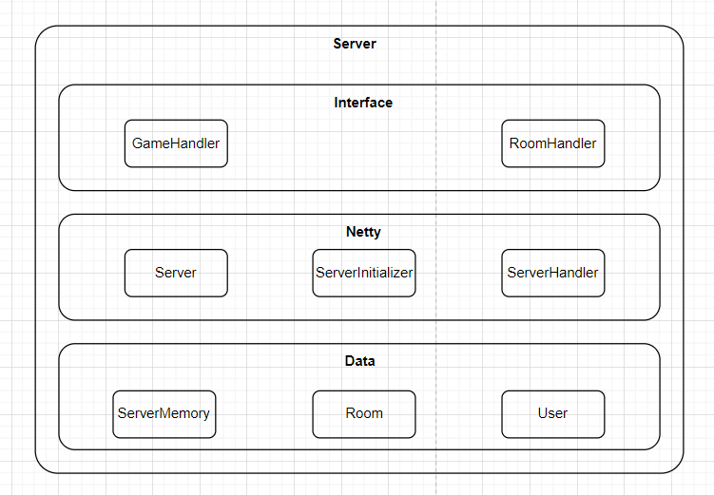
System Architecture
Notes:
Here’s the architecture diagram of the server. It includes:
the interface: which interacts with the client
the netty: which provides the interface with the information it requires
and the data

Slide 15
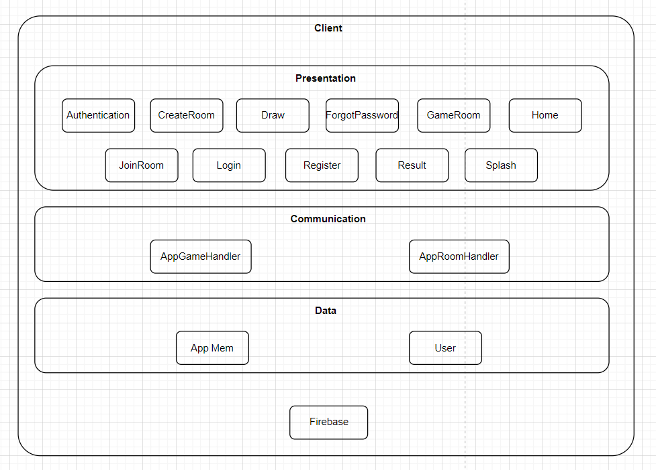
System Architecture
Notes:
The client architecture is similar. It involves a presentation layer, a communication layer, a data layer and the firebase – which stores user login.

Slide 16
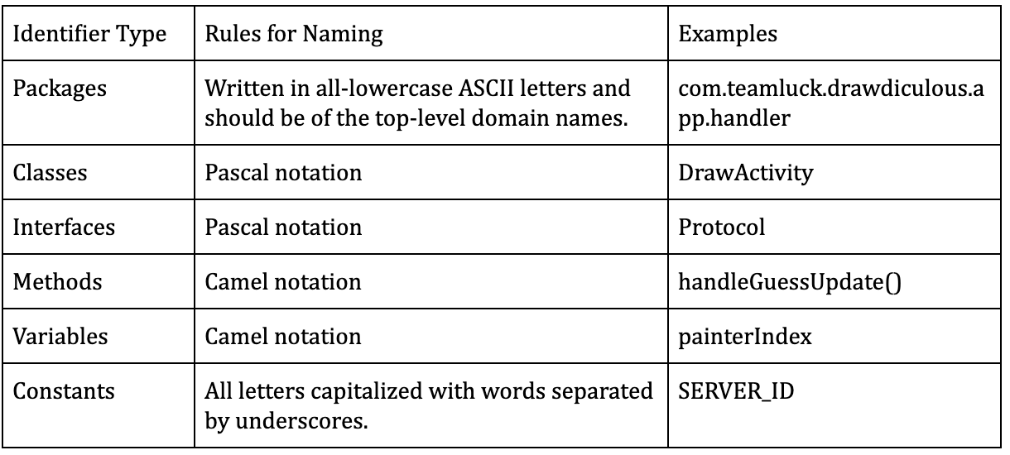
Standardization
Followed OOP best practices
Followed naming convention
Notes:
Standardisation was a big consideration when working on the application code and documentation.
The team followed standard OOP best practices. Additionally, SOLID principles were also incorporated to allow for cleaner, more maintainable code.
Standard naming conventions were also adopted as shown in the table.

Slide 17
Standardization
3. Quality plan followed the IEEE 730-2914 Software Quality Assurance Standard (IEEE 730)
IEEE 730 establishes requirements for initiating, planning, controlling, and executing the Software Quality Assurance (SQA) process of a software development project.
Ensures our application is confident in conforming to its established requirements.
4. Test plan followed the IEEE 829-2008 Software and System Test Documentation Standard
Defined the test tasks.
Identifies the system considerations that test processes and tasks address in determining application correctness and other attributes.
Notes:
Lastly, we incorporated IEEE documentation standards in both the quality plan and test plan to ensure that the application functions correctly and conforms to established requirements.

Slide 18





Configuration Management
GitHub
Google Drive
Issue Tracking and Project Management
Document Organization
Deliverable Submission
File Storage and Collaboration
Version Control
Notes:
The following tools were used to keep track of the project code and documentation.
Media Wiki was used for document organisation
Deliverables were submitted via Tortoise SVN
Github was used for code version control
Google Drive allowed for file storage and efficient collaboration
Lastly JIRA helped the team keep track of deliverables and maintain progress

Slide 19
Software Quality Assurance

Slide 20
Proper Documentation
Following documents will be assessed by SQ personnels.
Clear and maintained documentation allows easy quality check and maintenance.
Minimum Document Requirement:
System Requirement Specifications
Quality Plan
Software Model Prototype
Risk Management Report
Design report on software maintainability
Configuration Management Plan
Change Management Plan
Release Plan
Test Plan

Slide 21
Software Reviews
SQ personnel will assess the review products to assure the following:
Product is developed according to specification
Correct information are presented
Entry and exit criteria are met
Appropriate documents are updated
SQ personnel will assess the following software reviews:
Project Plan Review
Requirements Analysis Review
Software Design Review
Test Plan Review
Acceptance Review

Slide 22
Thorough Testing
Functional Testing
Unit Testing:
Tests individual and standalone modules to check if there are any issues.
Integration Testing:
Software modules are integrated logically and tested as a group.
User Acceptance Testing:
Conducted in the last phase to let the target user to test.
Non-functional Testing
Compatibility Testing:
Test to check if application is capable of running on different Android devices。

Slide 23
Project Management

Slide 24
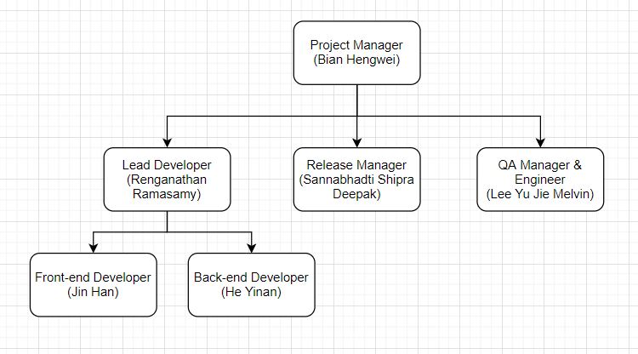
Project Organization
Notes:
Our project organization is shown in this figure.
I am the project manager. I am managing our Lead Developer Rama, our Release Manager Shipra, and our QA Manager and QA Engineer Melvin.
We also have Jin Han who is our Frontend Developer, and Yinan who is our Backend developer. They are lead by Rama.

Slide 25
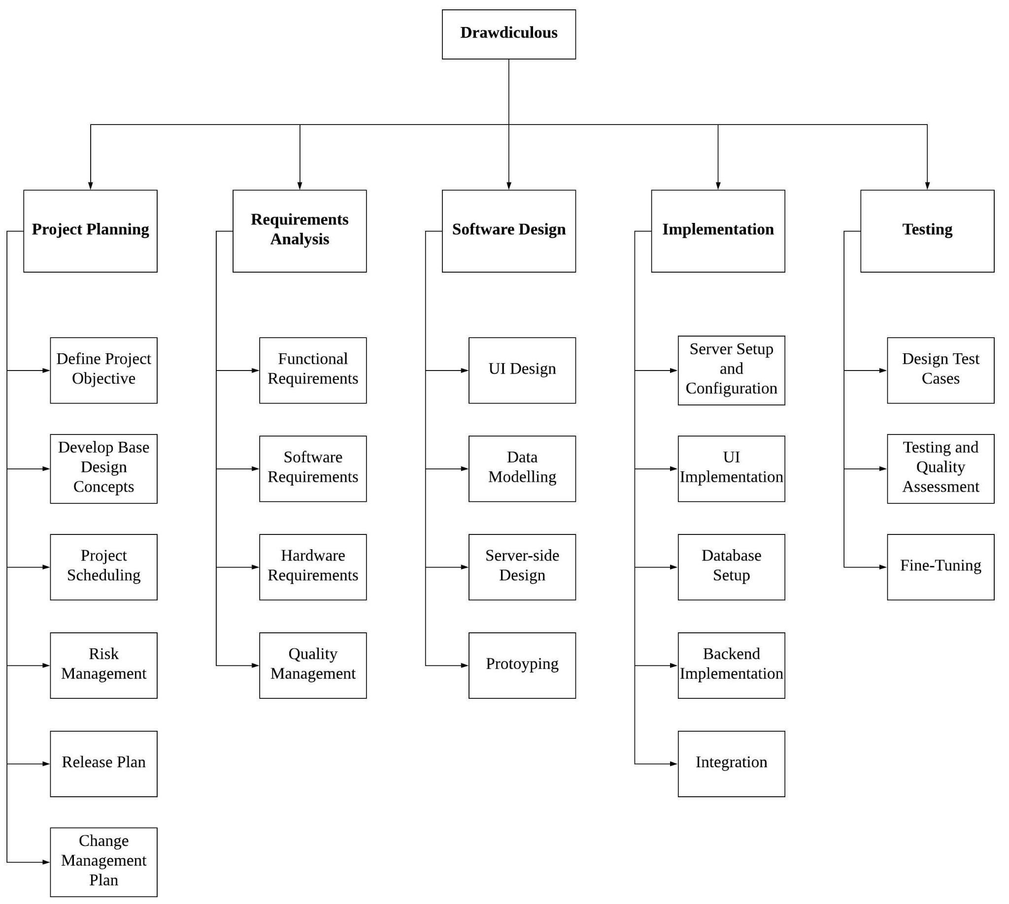
Work Breakdown Structure
Notes:
This is a figure showing our work breakdown structure. Our work is broken down into five phases, that are Project Planning, Requirement Analysis, Software Design, Implementation and Testing. Each of them are divided into subtasks as shown in the figure for further scheduling and collaboration.

Slide 26
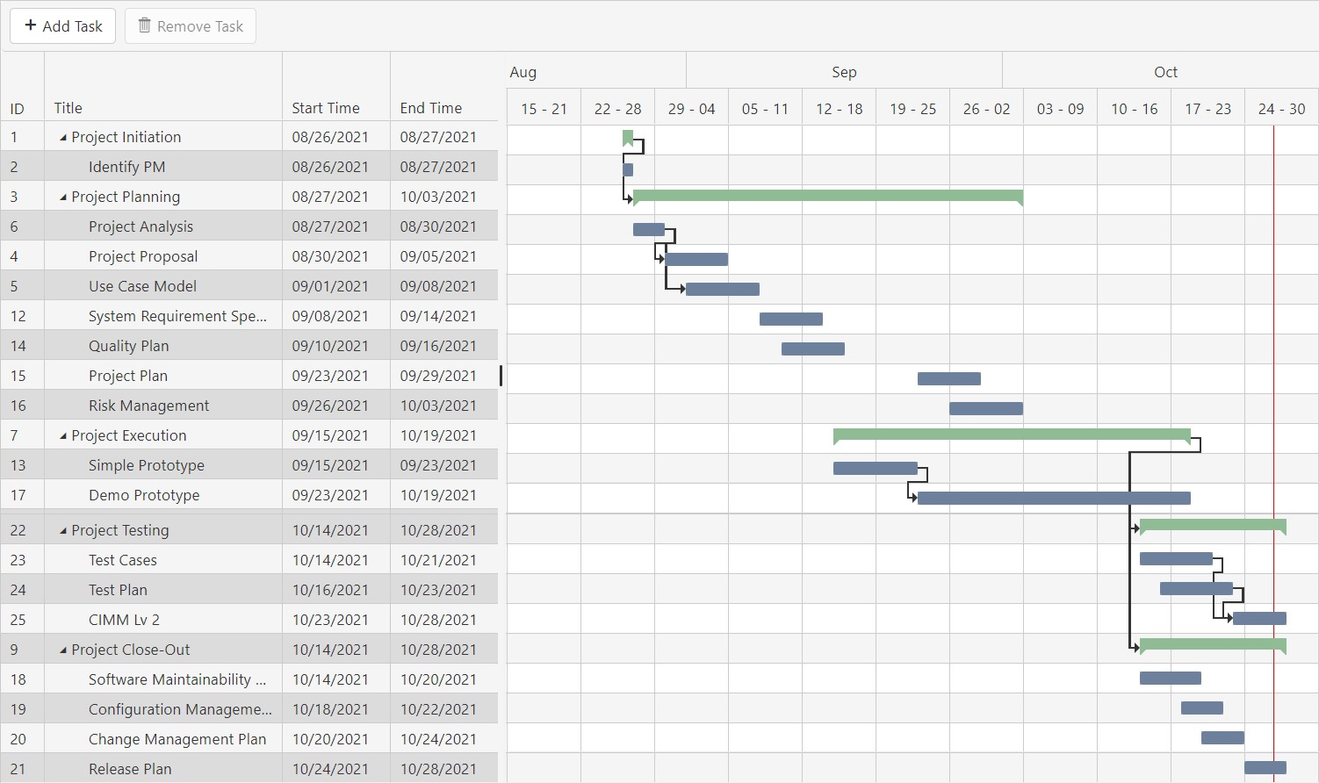
Timeline
Notes:
This figure shows the exact schedule and timeline of our project. We can see the duration of the project is from late Aug to late Oct. The timeline contains different subtasks, each has a start time and end time. We strictly follow this gantt chart while doing our project to ensure that all the deliverables are done by its deadline, and can be submitted to our stakeholders on time.

Slide 27
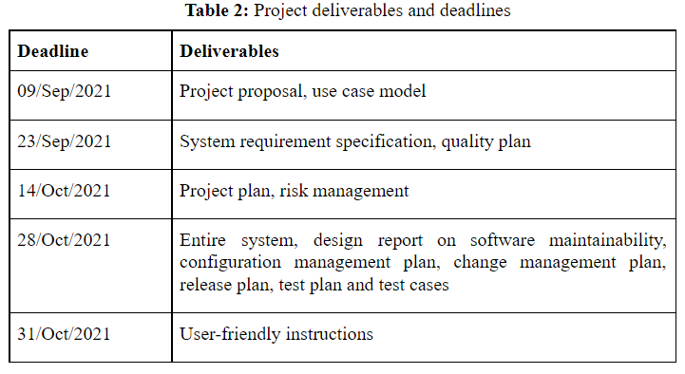
Deliverables and Deadlines
Notes:
Here is a list of deliverables and their deadlines. We write and maintain a list of documents to make sure that project requirements are fulfilled and to establish traceability concerning what has been done. We also provide the deliverables to our stakeholders.

Slide 28
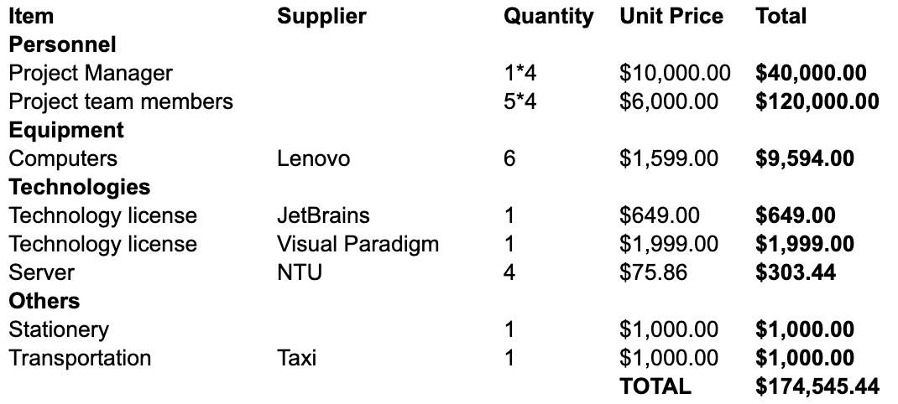
Budget
Notes:
We also have a budget plan. The total budget of our project is 174K Singapore dollars. This includes our salary, some equipments, some development tools, and other budget.

Slide 29
Risk Management

Slide 30
Purpose
Identify, assess, respond to, monitor, and report risks
Notes:
What is risk management? Risk management is to identify, assess and responds to the risk involved in a project. A risk can be anything that could hold an impact to the deliverable of the project, or the profits generated from the project. Therefore, it is important to review and respond to each individual risk.

Slide 31
Risk Analysis
Lower Risk
Higher Risk
Impact | 5 | 5 | 10 | 15 | 20 | 25
 | 4 | 4 | 8 | 12 | 16 | 20
 | 3 | 3 | 6 | 9 | 12 | 15
 | 2 | 2 | 4 | 6 | 8 | 10
 | 1 | 1 | 2 | 3 | 4 | 5
 |  | 1 | 2 | 3 | 4 | 5
 | Probability
5– Greater than 80% probability of occurrence
4 – Between 60% and 80% probability of occurrence
3 – Between 40% and 60% probability of occurrence
2 – Between 20% and 40% probability of occurrence
1 – Below 20% probability of occurrence
5 – Risk that has the potential to severely impact project cost, project schedule or performance
4 – Risk that has the potential to significantly impact project cost, project schedule or performance
3 – Risk that has the potential to moderately impact on cost, schedule or performance
2 – Risk that has the potential to minorly impact on cost, schedule or performance
1 – Risk that has relatively no impact on cost, schedule or performance
Notes:
So how to we analysis the risk? We will be using a 5 by 5 matrix for risk analysis. Each risk will be analysed based on two scales, severity (aka Impact) and Probability. A high severity or a high probability of occurrence of the risk will result in a rating of 5 at the respective scales. <CLICK> The ratings from the 2 scales are then multiplied together to form a risk probability number or RPN. <CLICK> Risks that have RPN of less than 8 are safe to proceed while <CLICK> risks that have RPN of greater than 16 needs proper risk mitigation planning before proceeding with the project.

Slide 32
Response Planning
Elimination
Avoid the threat by eliminating the cause
Substitution
Replace the cause of risk with another similar cause but providing less impactful.
Effectiveness
Administrative
Alert the existence of risk and ways to prevent it.
Transfer
Make other party responsible for it
Notes:
There are 4 types of risk mitigation or respond planning that we will be using. At the topmost step, we will be using elimination to eliminate all possible risk. This is the most effective method in risk mitigation. <CLICK> Next, we will use substitution which replace the cause of risk with another, but produce a minor risk as compared previously. <CLICK> We can also use administrative measures where the risks are let known to all members of the project, including the stakeholder, and the method of it from occurrence. However, the risk will still occur if the user decided to overlook the risk, be it intentionally or accidentally (Human Factor). <CLICK> A transfer of risk, or the responsibility of it, to a third party should only be applied when all the above measures could not mitigate the risk. An example of it is buying of insurance for the server. Through the above 4 methods, each risk may have more than 1 response plan or even a mixture of different method in a single plan to reduce the likelihood and the severity of the risk.

Slide 33
Live Demo

